Slide 1
Internet movie Database(IMDB)
SQL – Reinforcement Project

Slide 2
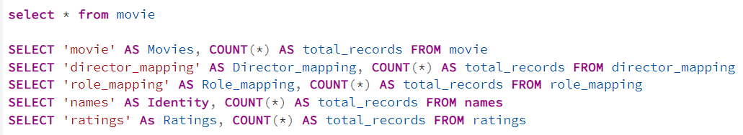





1. Count the total number of records in each table of the database.

Slide 3
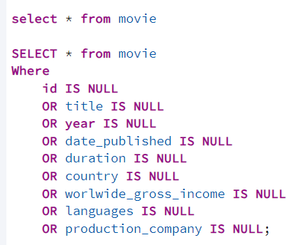
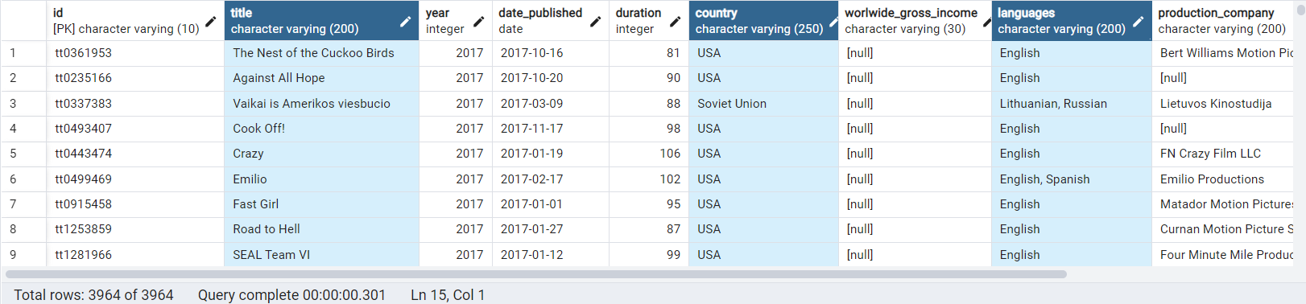
2. Identify which columns in the movie table contain null values.

Slide 4
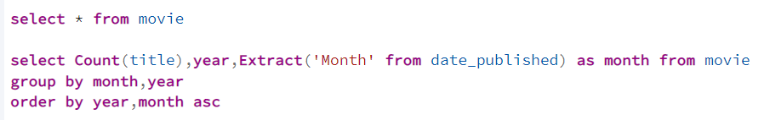
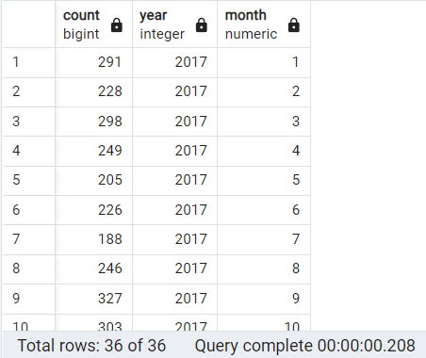
3. Determine the total number of movies released each year, and analyze how the trend changes month-wise.

Slide 5
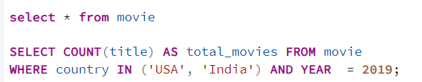

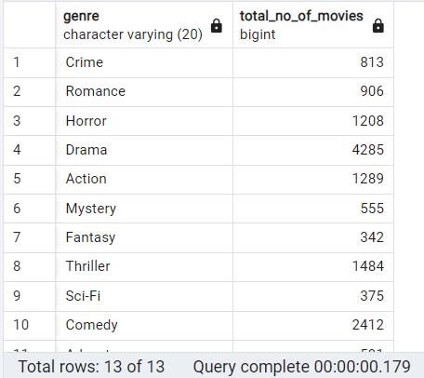
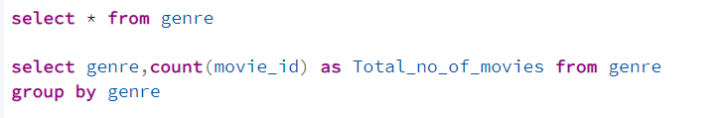
5. List the unique genres in the dataset, and count how many movies belong exclusively to one genre.
4. How many movies were produced in either the USA or India in the year 2019?

Slide 6
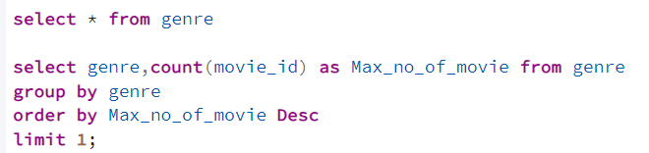

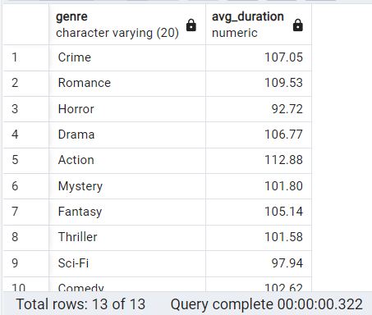
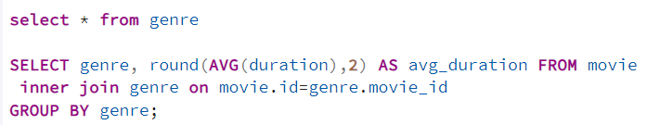
7. Calculate the average movie duration for each genre.
6. Which genre has the highest total number of movies produced?

Slide 7
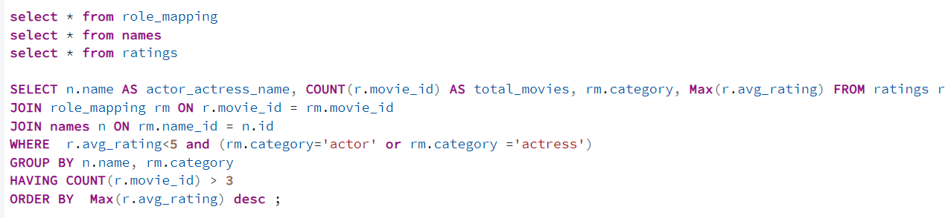
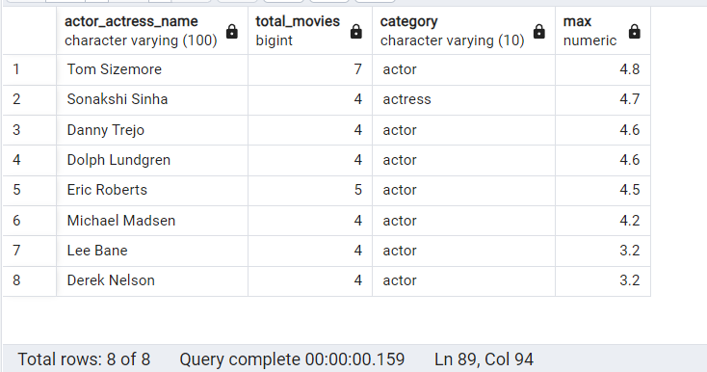
8. Identify actors or actresses who have appeared in more than three movies with an average rating below 5.

Slide 8
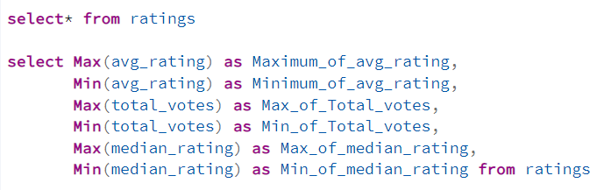
9. Find the minimum and maximum values for each column in the ratings table, excluding the movie_id column.

Slide 9
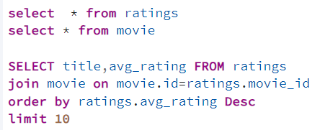
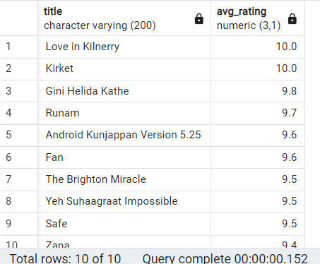
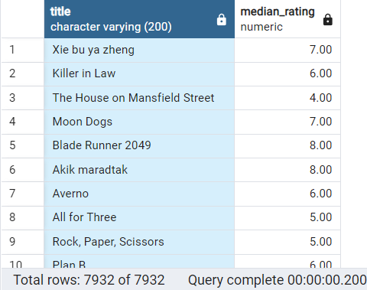
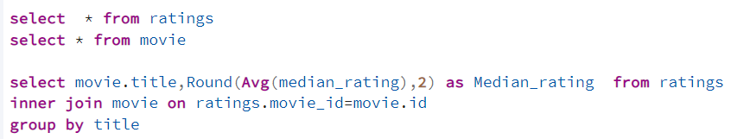
10. Which are the top 10 movies based on their average rating?
11. Summarize the ratings table by grouping movies based on their median ratings.

Slide 10
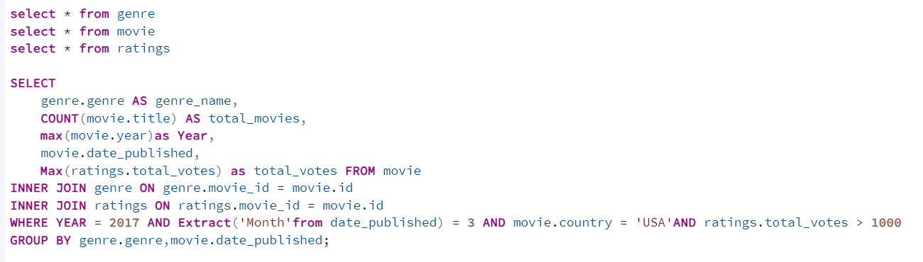
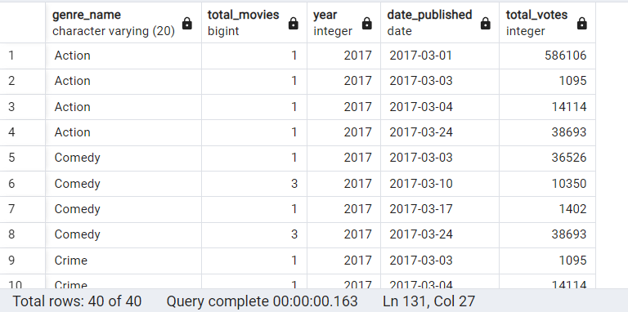
12. How many movies, released in March 2017 in the USA within a specific genre, had more than 1,000 votes?

Slide 11
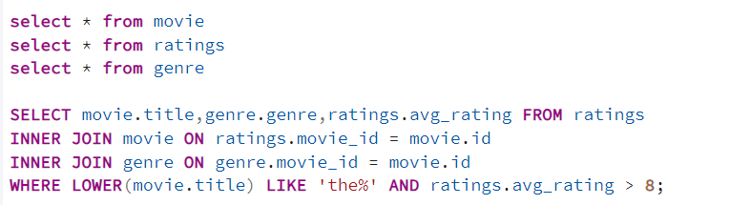
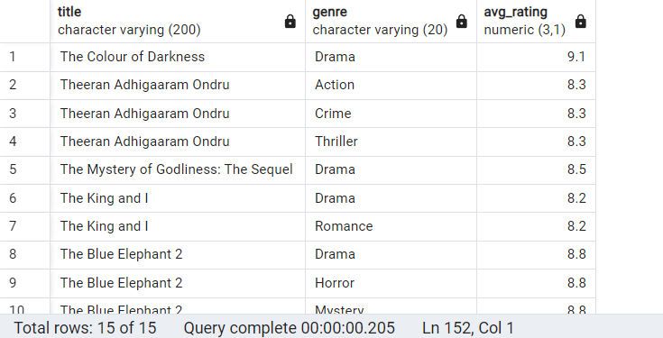
13. Find movies from each genre that begin with the word “The” and have an average rating greater than 8.

Slide 12
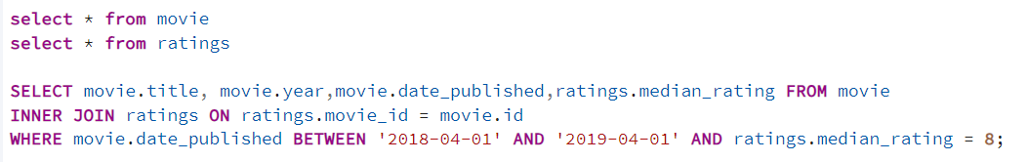
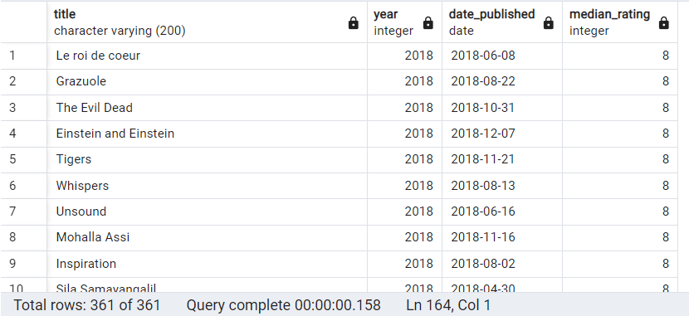
14. Of the movies released between April 1, 2018, and April 1, 2019, how many received a median rating of 8?

Slide 13
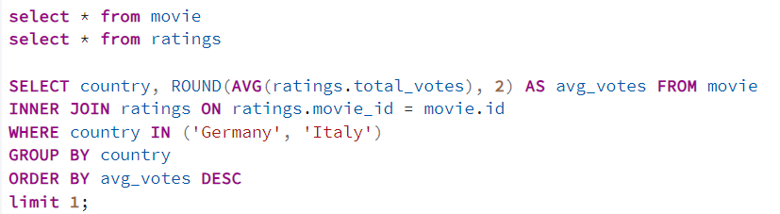

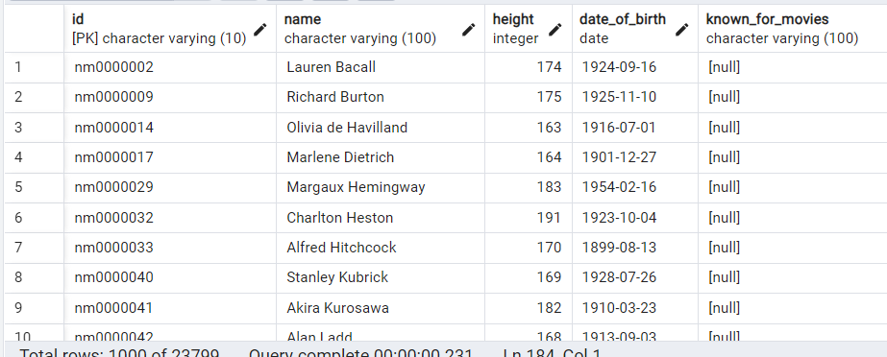
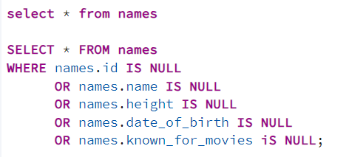
15. Do German movies receive more votes on average than Italian movies?
16. Identify the columns in the names table that contain null values.

Slide 14
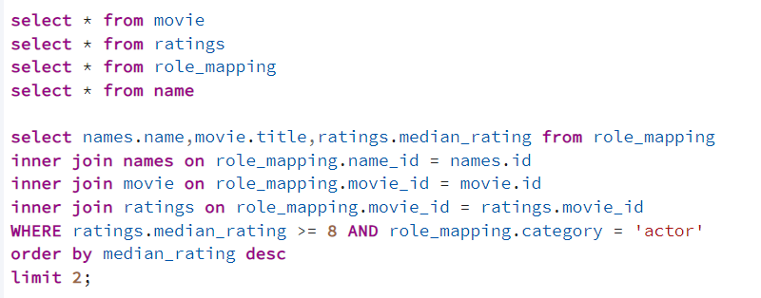
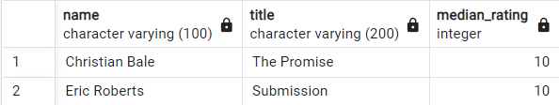
17. Who are the top two actors whose movies have a median rating of 8 or higher?

Slide 15
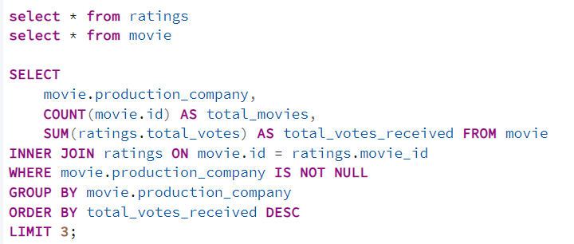
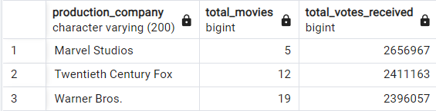
18. Which are the top three production companies based on the total number of votes their movies received?

Slide 16
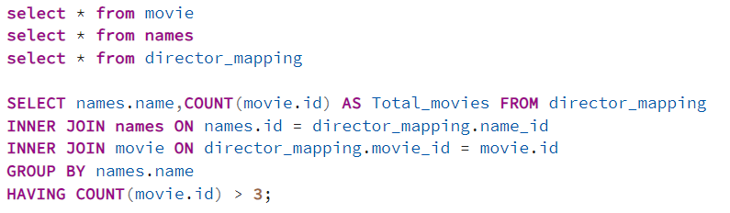
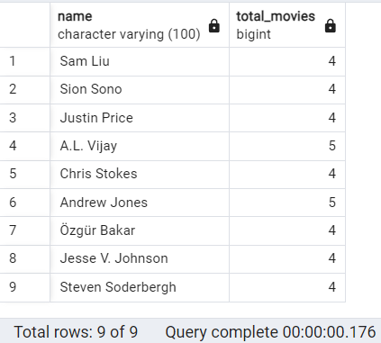
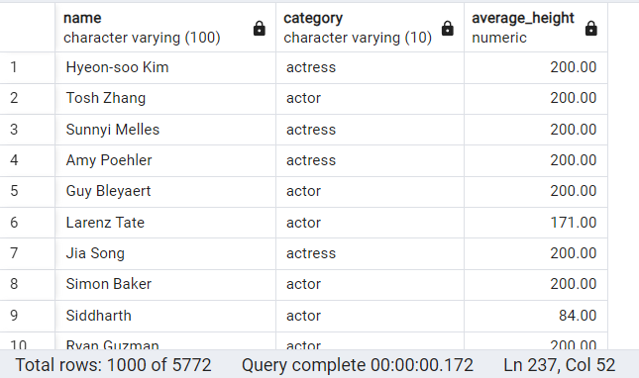

19. How many directors have worked on more than three movies?
20. Calculate the average height of actors and actresses separately.

Slide 17
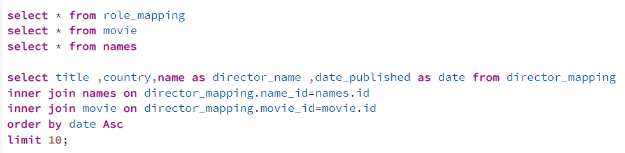
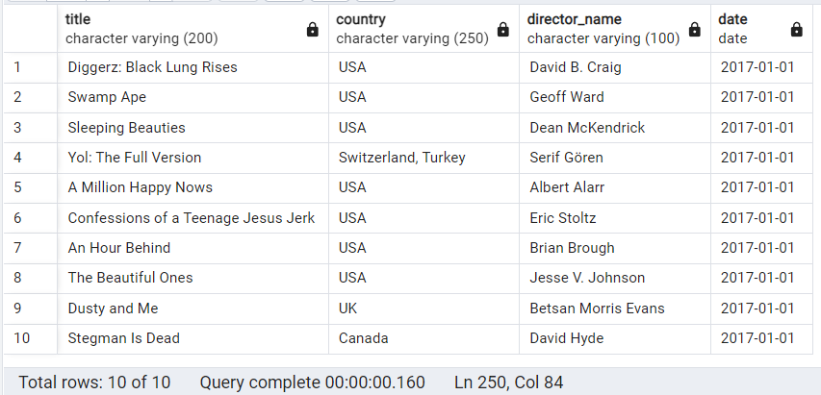
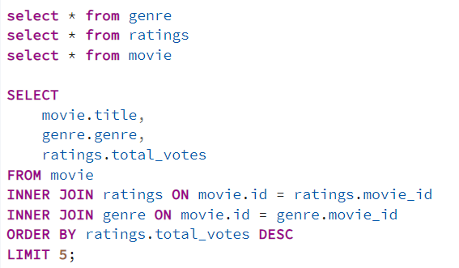
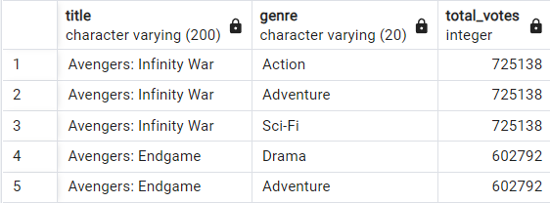
21. List the 10 oldest movies in the dataset along with their title, country, and director.
22. List the top 5 movies with the highest total votes, along with their genres.

Slide 18
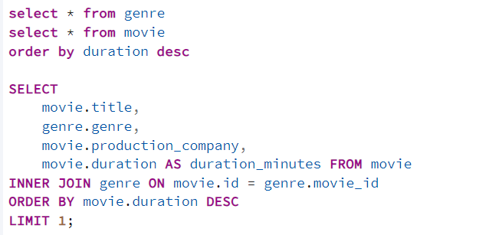
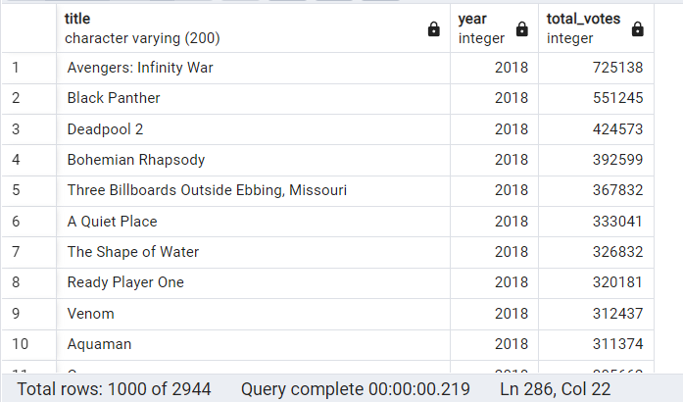
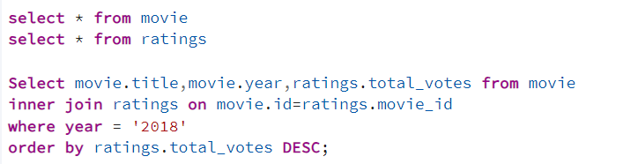
23. Identify the movie with the longest duration, along with its genre and production company.
24. Determine the total number of votes for each movie released in 2018.

Slide 19
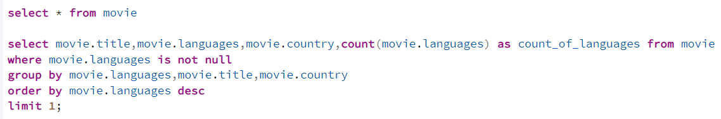

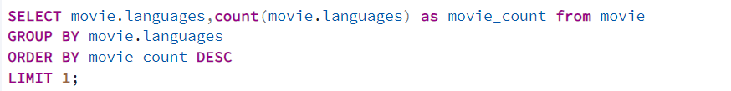

25. What is the most common language in which movies were produced?

Slide 20


